Slide 1
Denis Pleshkov
(Senior) C++ Developer

Slide 2
About me
I do love designing and implementing a cool/complex things which could simplify my work and/or other one’s.
More than 10 years of production experience with C++/Qt.
Hobby: Linear Algebra, Linear ODE, FEA, Vibration Theory, bike riding, Control Theory, Rubik's cube, drum playing

Slide 3
Knowledge
Win/ Linux
C++/Qt/ Math
Math. Simulation
Numpy

Slide 4
AD for OEM from Munich

Slide 5



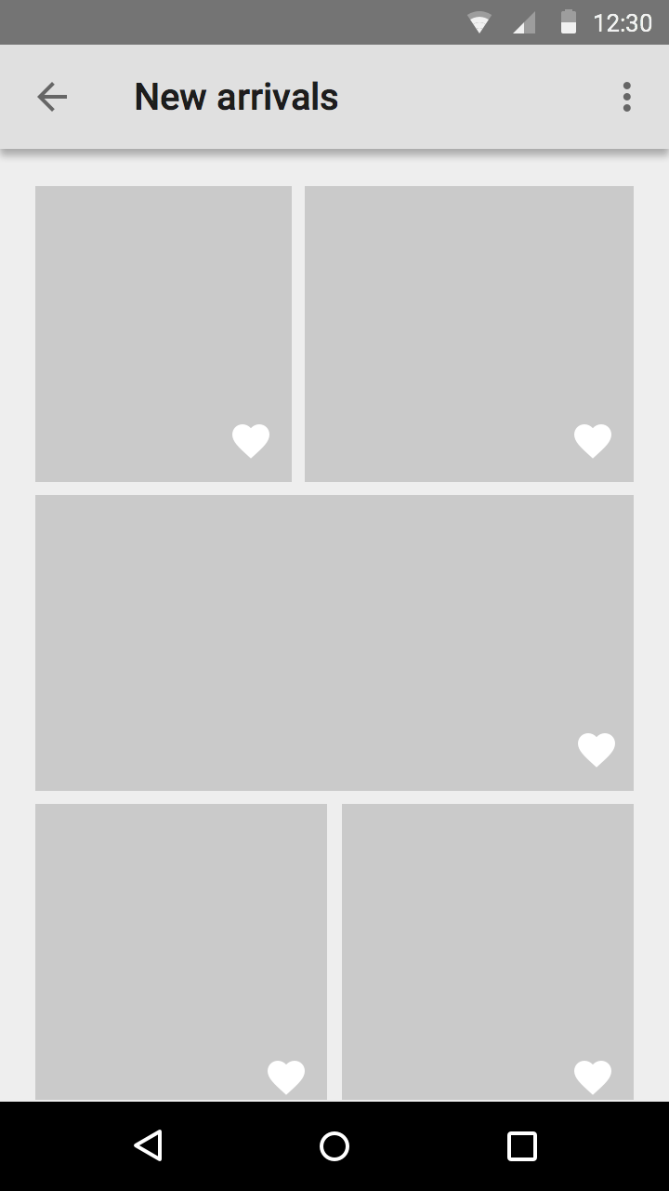
Project name: NDA (Aug2021-now)
Low level functionality for data transfer between ECU’s and HeadUnit (FrancaIDL/AutoSAR)
Math.Library: Common Wrapper, Linear Algebra, Optimization, Kalman Filtration, Rectangles Intersection in 2D
Found error in Intel AdLib (https://en.wikipedia.org/wiki/Hungarian_algorithm)
Tech. stack: C++14/Python (Numpy, Jupyter), Bazel/FrancaIDL/Blaze/AdLib, vsCode

Slide 6
HMI for OEM from Stuttgart

Slide 7
Project name: NDA (Jan2016-Aug2021)
Rich GUI for HMI/Navigation
Instrument Cluster display (no simulator, no debug, only dlt-logs)
Virtual keyboard
Check translation files (Kotlin)
Tech. stack: C++14/Qt/Qml/C#/cmake/dlt-viewer, Qt Creator

Slide 8
TeamCenter’s plugin

Slide 9
Project name: Digital signature (Dec2013-Dec2015)
Secured document’s flow with digital signature
Plugin for TeamCenter (https://www.plm.automation.siemens.com/global/en/products/teamcenter )
Tech.stack: Java, JNI, C++, Qt, QtCreator/Eclipse
3rd-party Crypto-Lib

Slide 10
Dynamic simulation

Slide 11
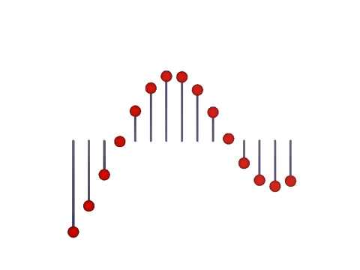
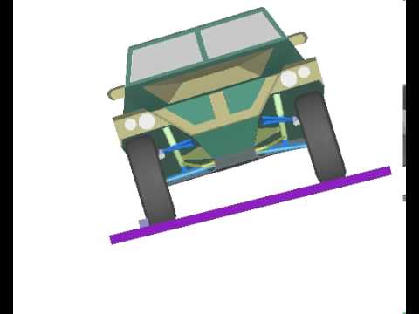
Project name: Euler, roboTester (Sep2006-Dec2013)
http://www.euler.ru simulate vehicle dynamics https://www.youtube.com/user/EulerCAE/videos
improve simulation core
interface to Simulink WorkShop
Node remuneration for Sparse Matrix representation
Craig-Bampton (https://en.wikipedia.org/wiki/Dynamic_substructuring )
Export data from CAD (NX, SolidWorks, Autodesk Inventor)
DSL for list comprehension
Tools for create custom Application
Tool for auto testing
CI-pipeline via bat-files
Fork boost::tuple, QDialog
Tech.stack: C++03/11, Boost, Qt, VStidio/QtCreator

Slide 12
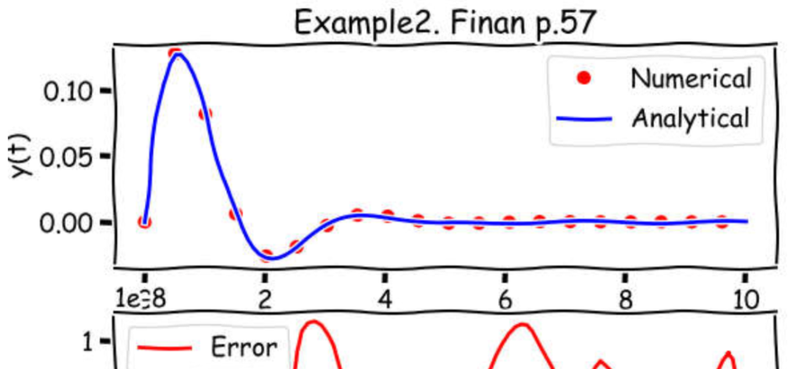
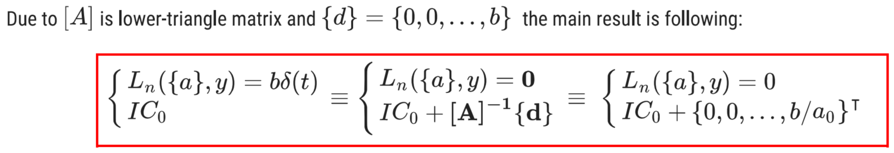
FEA
Control theory
Finite Element Analysis of an Inverse Problem Static/Dynamics
Direct problem: find x from [K]{x}={P}
Inverse problem: having [K] and x_i, find {x} and P_i
same for dynamics problem
Transient analysis
Steady state response
Sensitivity analysis
Calculate transfer function by Adjacency Matrix
Transient analysis for input with Dirac delta function
https://github.com/stdapproach/ppt/blob/main/solveLinearOdeDeltaFunction.pdf

Slide 13
Why circuit
CLI for editing/simulation/analysis of model
State Equation (Observability/Controllability)
Transient analysis (Free response, Impulse response, nonZero IC
Transfer function
Parallel Sparse direct Solver
Inverse problem: find parameter value delivering expected characteristics
Sensitivity analysis
Optimization problem
Model reduction
Krylov subspace projection
Structure preserving reduced order
? Craig-Bampton analog ?
PhD?

Slide 14

Contact
Denis Pleshkov
std.approach@gmail.com
github.com/stdapproach/ppt

